Slide 1


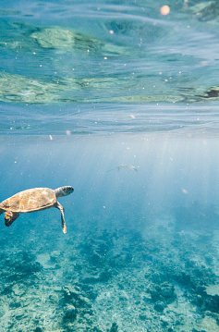
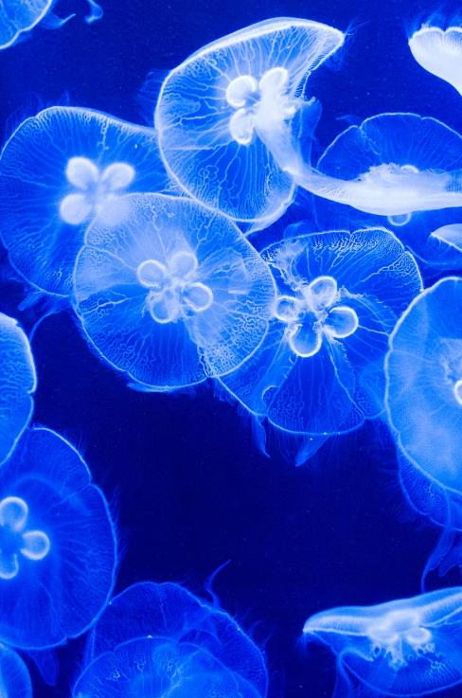
Biodiversity conservation

Slide 2
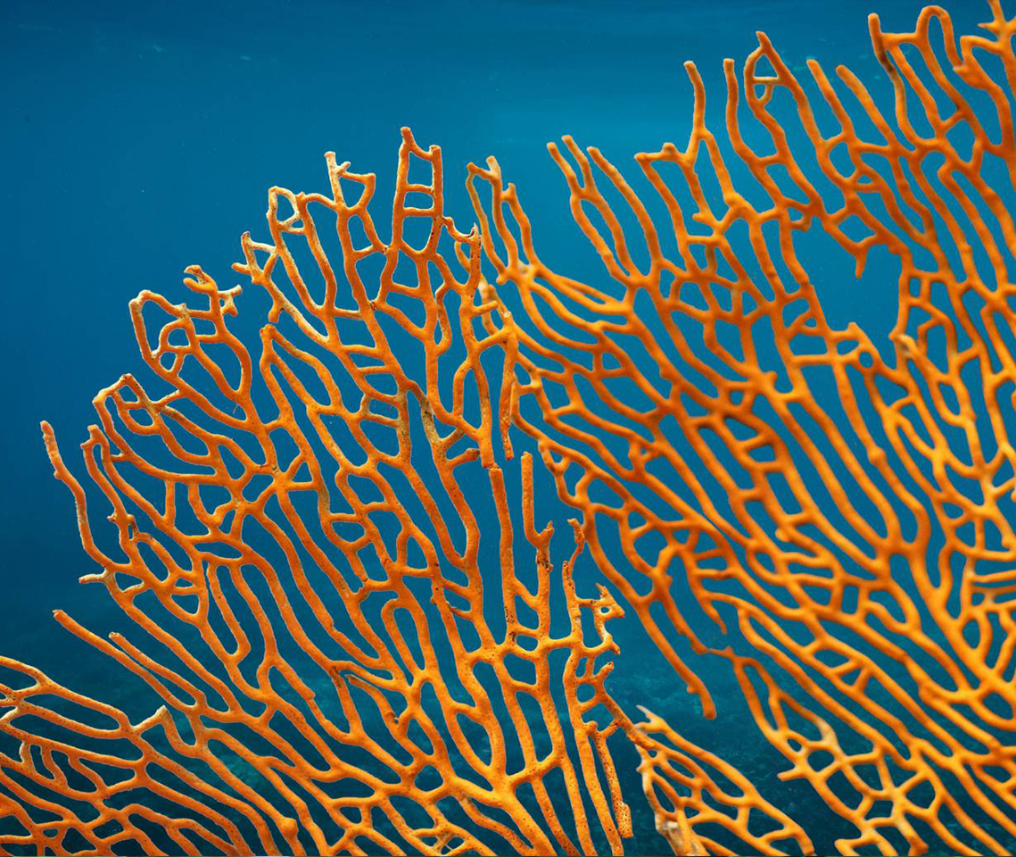
AGENDA
Introduction
Need for conservation
Types of conservation
How to conserve

Slide 3

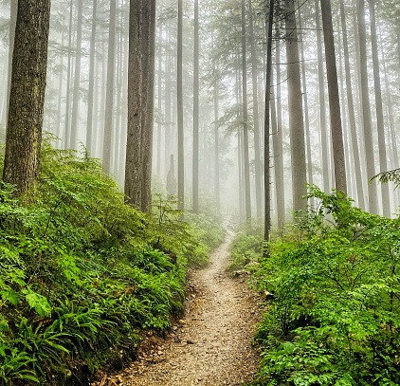
Why should we conserve biodiversity?
There are many reasons, some are obvious like
To protect wildlife
To protect the earth
For human health
Some are not so obvious like
Biodiversity is necessary for the maintenance of genetic diversity
Biodiversity provides us with medications and medicines etc
But all reasons are equally important.

Slide 4
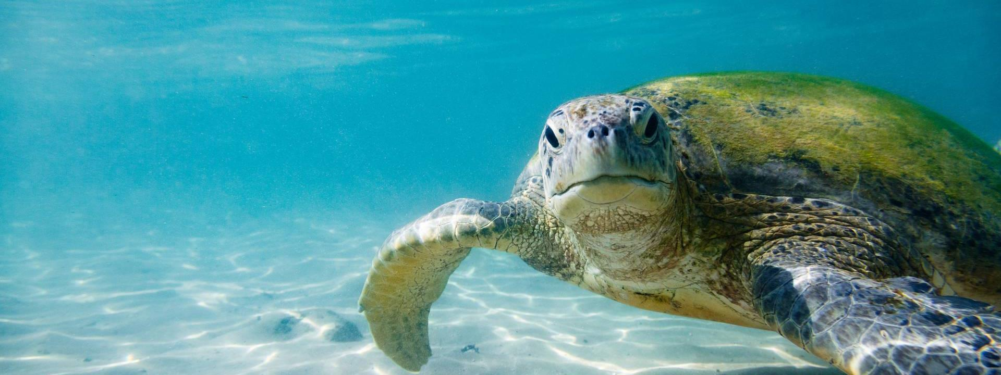
types of reasons to conserve biodiversity

Slide 5
REASONS ARE OF THREE TYPES
ETHICAL
BROADLY UTILITARIAN
NARROWLY UTILITARIAN

Slide 6
NARROWLY UTILITARIAN
The narrowly utilitarian arguments for conserving biodiversity are obvious, humans derive countless direct economic benefits from nature as
Food –cereals ,pulses, fruits
Firewood
Fiber
Construction materials
Industrial products-tannins,lubricants,dyes,resins,perfumes
Products of medical importance

Slide 7
More than 25% of drugs currently sold in the markets worldwide are derived from plants .
25,000 species of plants contribute to the traditional medicines used by the native people around the world
With increasing resources put into “BIOPROSPECTING” nations with rich biodiversity can expect to reap enormous benefits .
Bioprospecting- refers to the exploring molecular genetic, species-level diversity for products of economic importance.

Slide 8
Broadly utilitarian
The broadly utilitarian argument says that biodiversity play a major role in many ecosystem services that nature provides.
The dwinding amazon forest is estimated to produce 20% of the total oxygen in the earths atmosphere (through photosynthesis).
(meanwhile it cost about 6,500 rupee per cylinder)
Pollionation is another service -without which plant cannot produce fruits or seeds

Slide 9
Ecosystem provides a number of pollinators –bees, bumblebees, birds, bats.
Then how nature stabilises our mood is priceless
like watching a rain , walking through woods ,watching spring flowers etc

Slide 10
ETHICAL
Without plants, animals, microbes the life on the earth will be impossible.
Thus every species have its own intrinsic value.
Many species face extinction through human action.
Humans have a responsibility to maintain species, ecosystems and habitats for future generations.

Slide 11
How do we conserve biodiversity ?

Slide 12
When we conserve and protect the whole ecosystem ,its biodiversity at all levels is protected.
We save the entire forest to save the tiger
This approach is called “ IN SITU” (means on site).
When an animal or plant is endangered or threatened and needs urgent measures to save it from extinction , then the suitable approach is “ EX SITU” (means off site)

Slide 13
IN SITU CONSERVATION
When nations are spending more money on development of the country ,they found out that its economically not feasible to conserve all their biological wealth.
Thus the number of species needed to be saved is increasing day by day
There are ‘biodiversity hotspots’ which are regions with very high levels of species richness and high degree of endemism.
endemism- refers to species confined to a particular and is not found any where else. Eg- Bicolored frog (Clinotarsus curtipes) is endemic to the Western Ghats of India.

Slide 14
Thus these biodiversity hotpots needs maximum protection.
Initially 25 and later 9 more were added to the list making a total of 34 biodiversity in all over the world.
These hotspots are also the regions of accelerated habitat loss.
Some of them are – western Ghats , sri Lanka ,indo-Burma and the Himalaya.
The total area covered by all thses hotpots are less than 2% of the earths total land area. But the number of species they collectively harbour is extremely high.
Thus protecting these hotspots could reduce the ongoing mass extinction by almost 30%.

Slide 15
In India ,ecologically unique and biodiversity –rich regions are legally protected as biosphere reserves ,national parks and sanctuaries.
India now has a total of
14 biosphere reserves
90 national parks
488 wildlife sanctuaries.
India also have a history of religious ,cultural traditions that emphasised protection of nature
In Meghalaya ,the sacred groves are the last refuges for a large number of rare and threatened plants.

Slide 16
Ex situ conservation
In this approach ,threatened animals and plants are taken out from their natural habitat and are placed in special setting where they can be protected and given special care.
For these purpose zoological parks ,botanical gardens and wildlife safari parks are used.
There are many animals which have been extinct in the wild but continued to maintained in the zoological parks .
Due to the advancement in technology now gametes of the threatened species can be preserved in viable and fertile condition for longer periods using cryopreservation.

Slide 17
Different genetic strains of seeds of commercial importance are been kept at seed banks for longer periods.
Thus these preserved eggs can be fertilised by in vitro and by tissue culture methods for the plants .

Slide 18
Biodiversity and its conservation is a collective responsibility of all nations .
a historic convention on biodiversity (the earth summit) held in Rio de janerio in 1992.
Which called upon all the nations to take measures for conservation of biodiversity and sustainable development of its benefits.

Slide 19
. In a follow-up, the World Summit on Sustainable Development held in 2002 in Johannesburg, South Africa, 190 countries pledged their commitment to achieve by 2010, a significant reduction in the current rate of biodiversity loss at global, regional and local levels.

